Slide 1
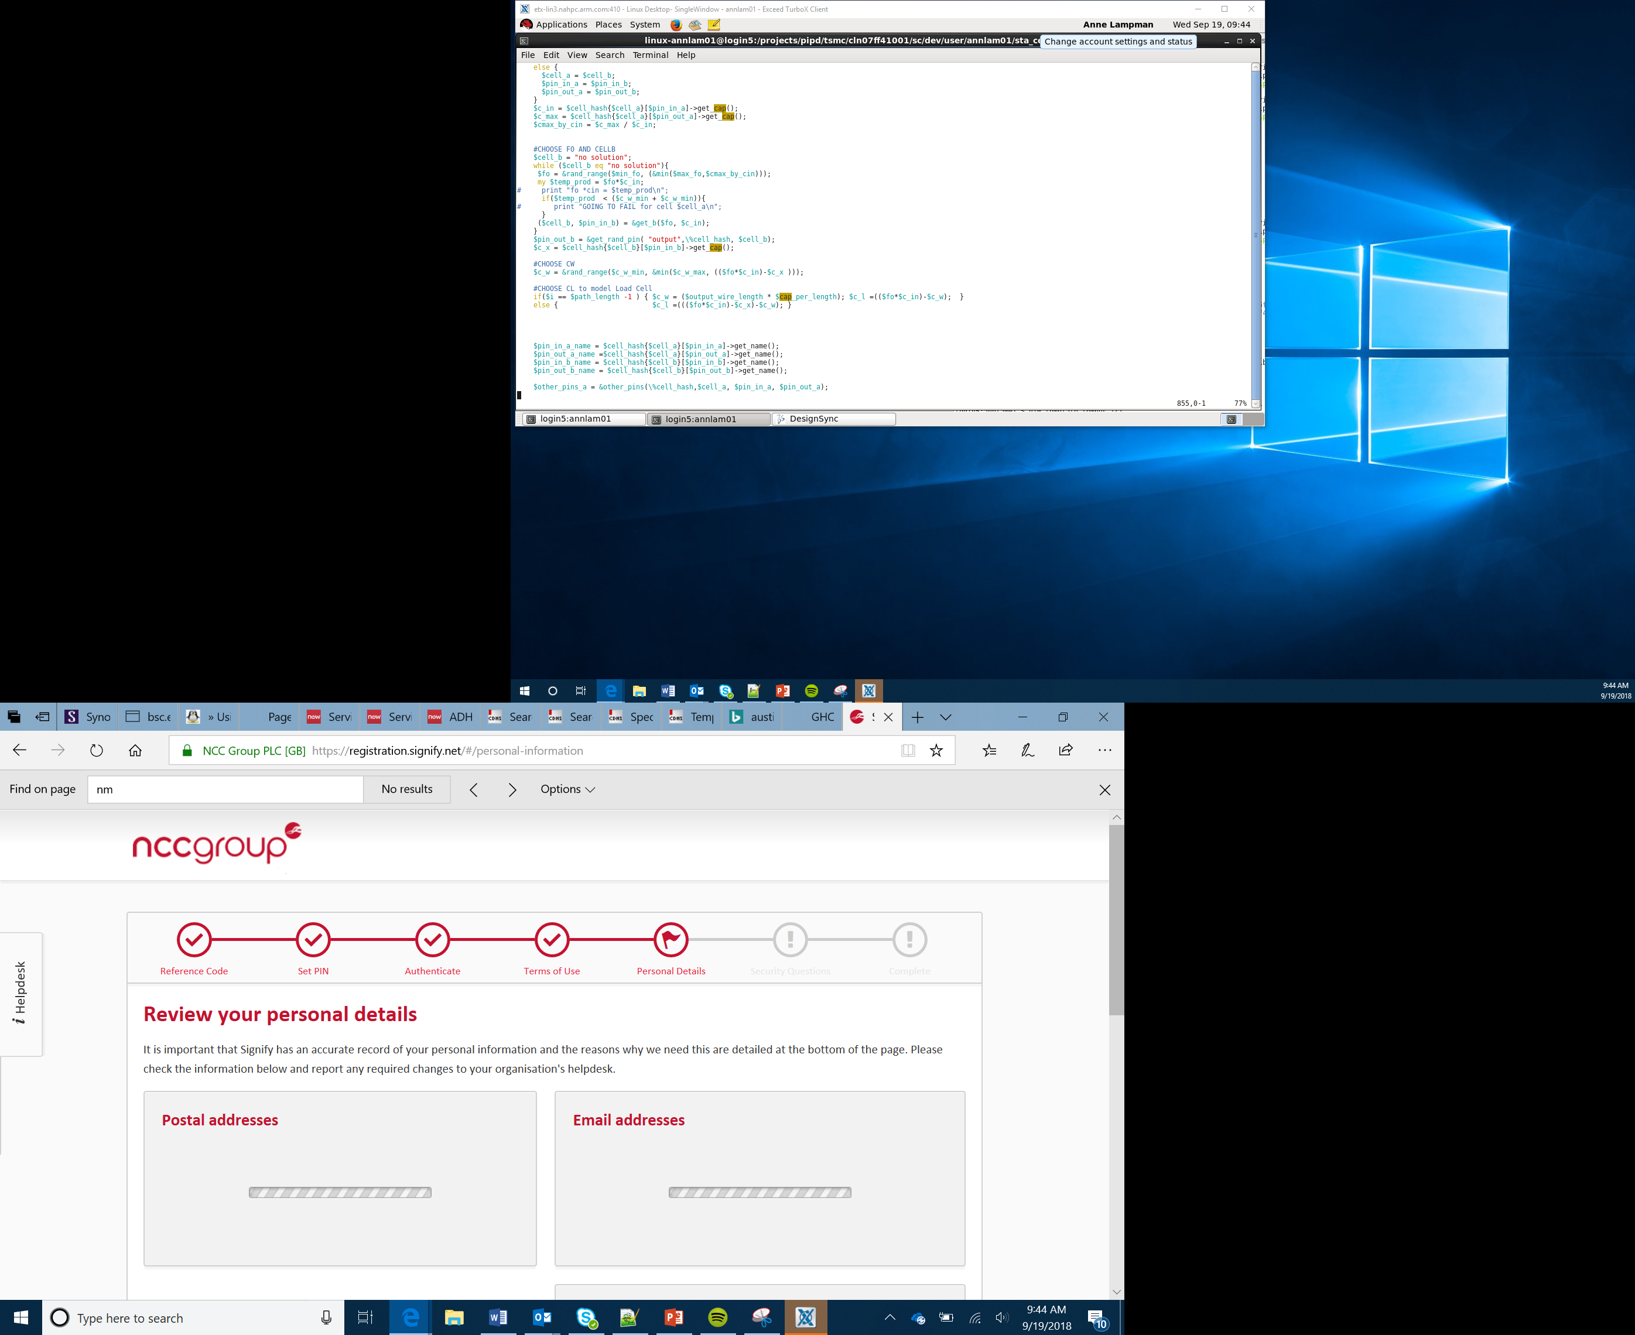

Air quality sensor
Lesson 3

Slide 2
Success criteria
Understand what a forever loop does
Understand what the air quality sensor measures
Understand that if code is only to be executed if a condition is true, then an ‘if then else’ statement can be used
Use a logical operator in a program
Consider what other applications the sensors could be used for in a product

Slide 3
Sensors
Sensors allow a computer to detect certain measurements
The measurements from a sensor will be processed and the micro:bitprogram can make decisions based on the value
Sensors can be analogue or digital:
Digital sensors can only detect a single status; for example, if a temperature is above 50ºC or not –they display the result as either a 1 or a 0
Analogue sensors continually measure values within a range
Notes:
Introduce learners to the term sensor. Explain that it is an input device which detects conditions in the environment and returns a value or signal to the microprocessor. Ask learners if they can think of any sensors they may have come across.

Slide 4
Types of sensor
Different sensors can detect different things
You are going to develop an air quality sensor which will upload readings to the Arduino cloud
There are a range of different sensors which can detect a wide variety of different things
Complete the Sensing your world worksheet, using the internet to help you
Notes:
Discuss other sensors with students.

Slide 5
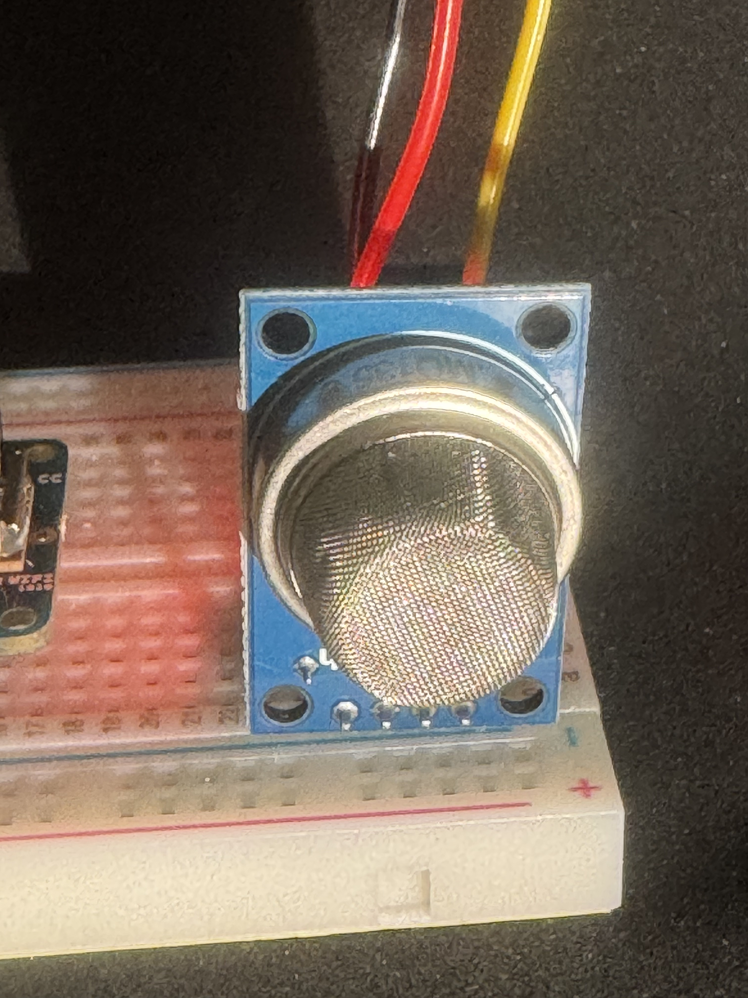
Air quality sensor
The air quality sensor can detect harmful gases such as carbon monoxide, alcohol, acetone, thinners or formaldehyde

Slide 6
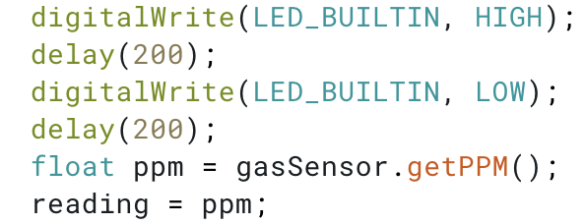
Program flow: sequence
When code is run line by line, in the same order every time this is known as sequence
Notes:
Ask learners to consider what sequence means. Discuss with them what situations might lead to programs needing to break sequence.

Slide 7
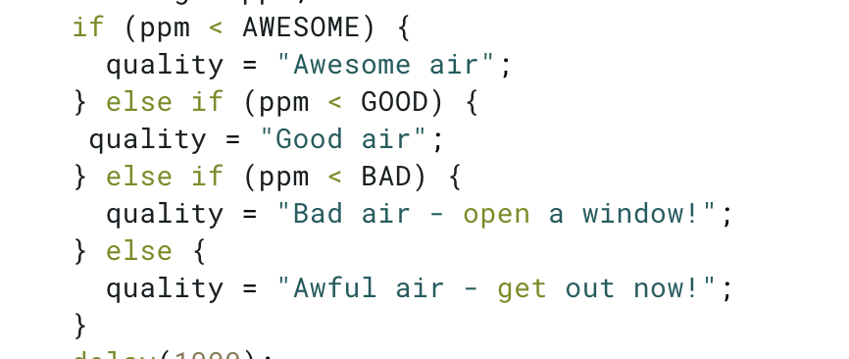
Program flow: selection
Do computer programs always take the same route through the code?
When code is only executed if a condition is true this is known as selection
Complete the If, then, else worksheet
Notes:
Discuss selection; identify the syntactical requirements. Discuss the use of constants. Introduce the concept of nested selection, else conditions, and why we only need to test one boundary at a time.

Slide 8
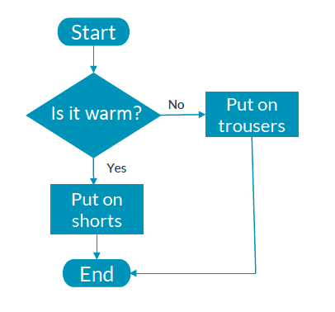
Program flow
Depending on the weather you may wish to dress differently. If we were to write this as an algorithm using a flow chart, what shape would we use for a decision?
Our basic getting dressed algorithm could look like the flow chart opposite:
As you can see from the flow chart:
You would only put on trousers if it is not warm
You would put on shorts if it is warm, taking a different route through the decision

Slide 9
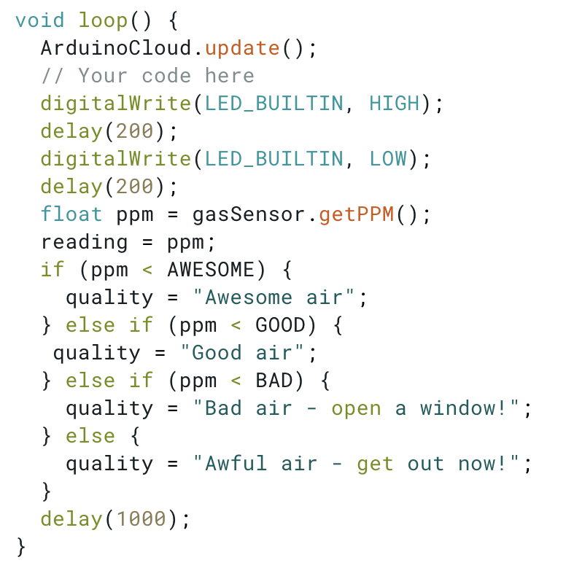
Endless loops
loop( ) is built into the Arduino language. It is the only one which loops forever
If you program an Arduino to detect the Air Quality, it is important that it does this continuously. To do this, we use a loop.
In the sample code, you can see that there is a delay of 1 second. This means that a value will be taken once per second. This can be adjusted as required.
Notes:
Introduce learners to the concept of loops. Discuss why some loops need to operate forever. Discuss the need for other types of loop.

Slide 10
void loop() explained
The void loop() runs all of the time and is a built-in function
The code measures a range of gases and outputs one of four different status:
Awesome air
Good air
Bad air – open a window!
Awful air – get out now!
gasSensor.getPPM() will get the reading from the sensor and store it in the variable ppm. This is then used in the if statement as the condition to determine which line should be execute
The variable quality will store the textual description.

Slide 11
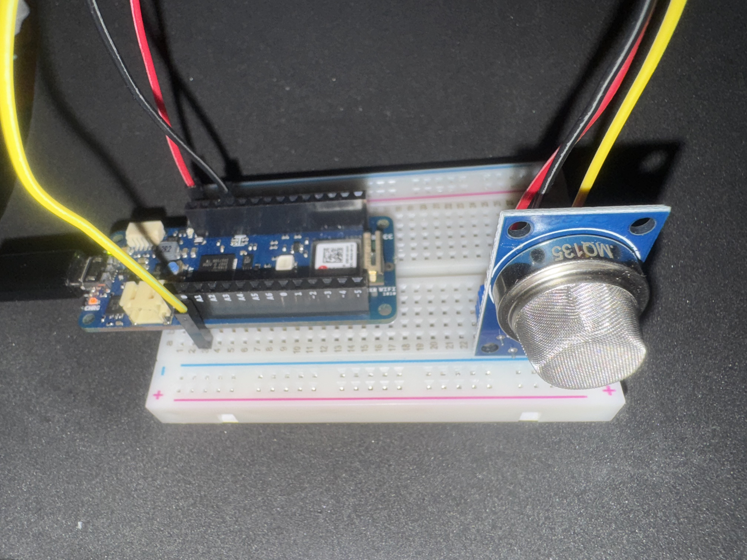
Assembling your device
You should now follow the initial instructions on the worksheet to connect your device.
Be very careful not to bend any of the pins
Notes:
All that is connected is positive, ground and A0.

Slide 12
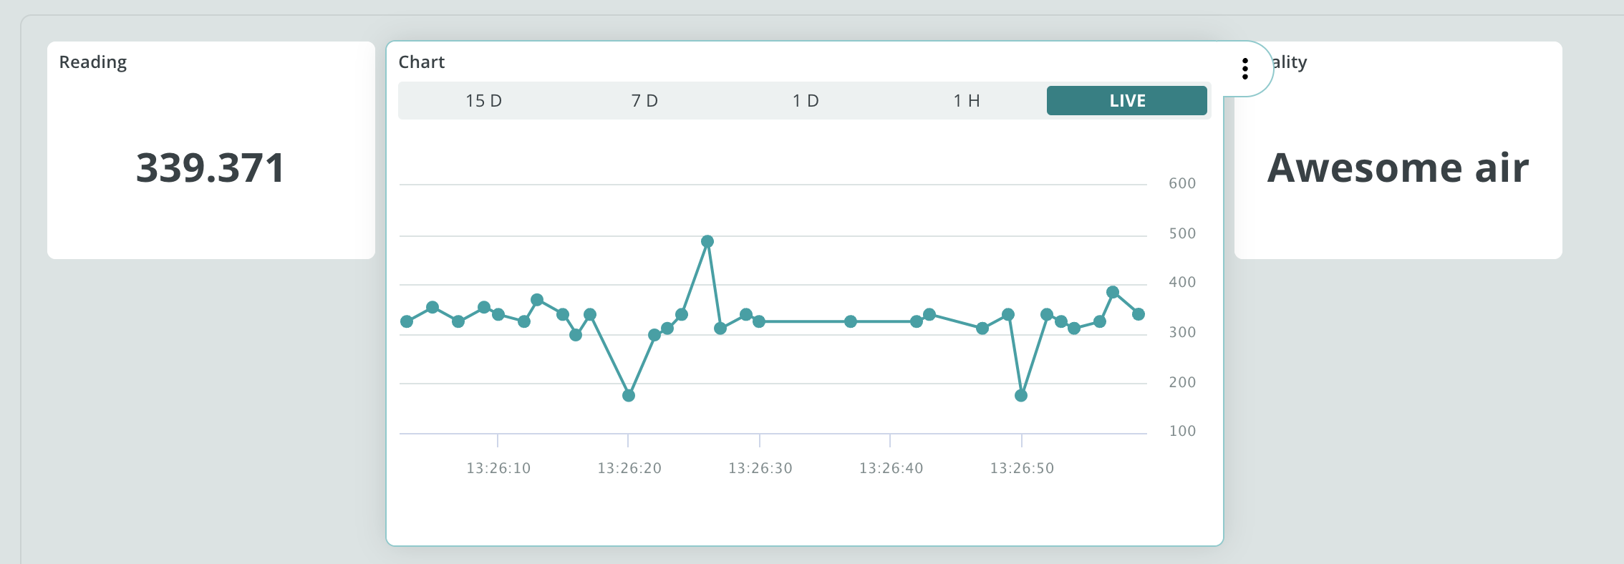
Writing your code
Continue working through the worksheet to create your own air quality monitor
Notes:
All that is connected is positive, ground and A0.

Slide 13
Extension activities
You could create a waterproof case to hold your device so that you can monitor the air quality around your environment at different times of the day. Please note that the device will need to be within wifi range. You could do this using an old plastic margarine tub. You will need to cut out a hole roughly the size of the sensor so that readings can be taken. Mount the holder to that the hole where the sensor is mounted points downwards so that rain will not get in
The device will also require a power source. Explore how to add a battery to your Arduino.
Notes:
All that is connected is positive, ground and A0.

Slide 14
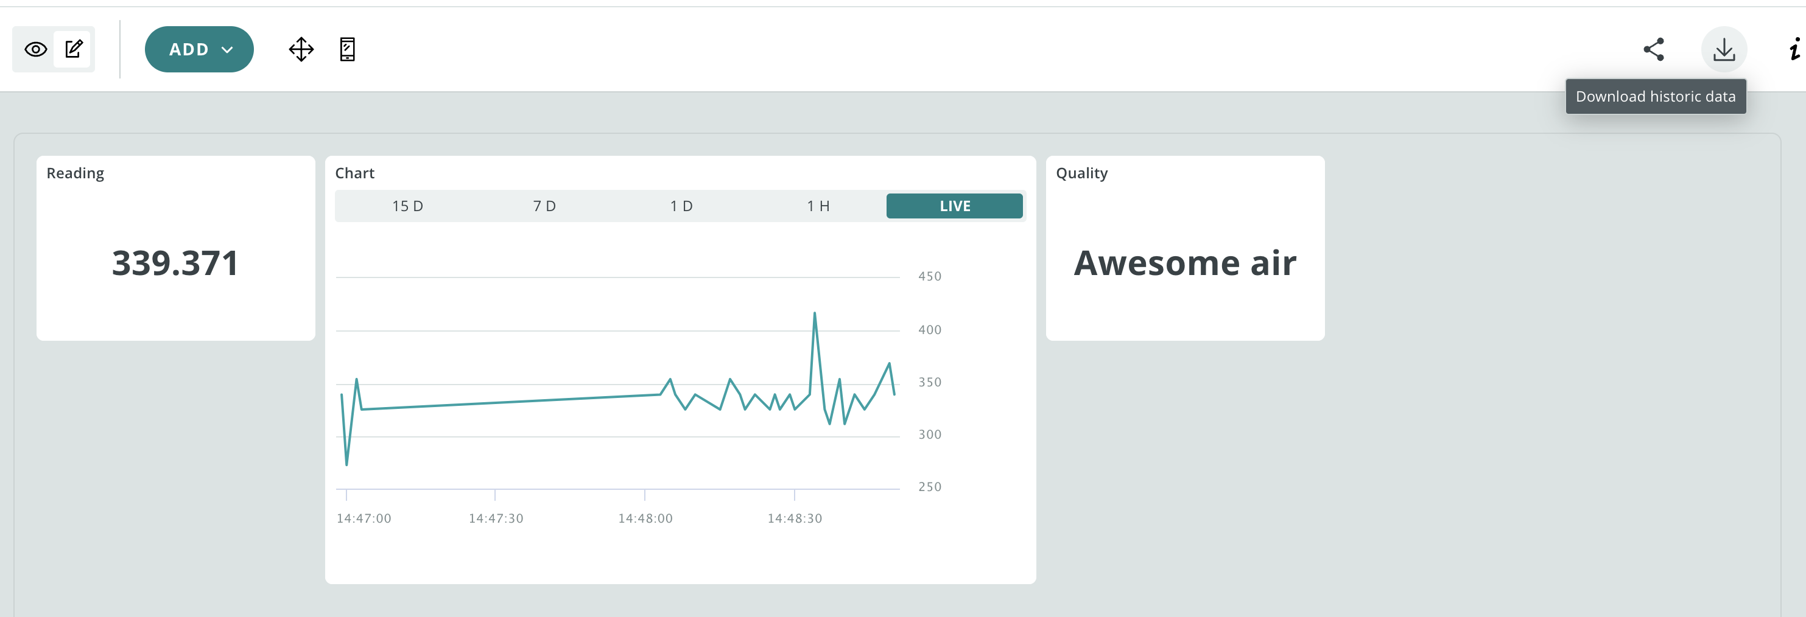
Exporting the data as a CSV file for analysis
A CSV file is a type of text file which separates the different values using a comma
To download the readings into a CSV file click on ‘download historic data’ from the IoT dashboard screen
Notes:
All that is connected is positive, ground and A0.

Slide 15
Summary
The Arduino IoT cloud can take readings from a range of sensors and display the data live on a dashboard
If a branch of code is only executed if a condition is true, this is known as selection
Loops within code is know as iteration

